Slide 1

Indirectness in Persuasion and Sales Messages
CHAPTER EIGHT

Slide 2
Indirectness in Persuasion and Sales Messages
Persuasive Requests
Sales

Slide 3
Preliminary Considerations in Writing Persuasive Requests (1 of 2)
Your goal is to ask for something the reader is likely to oppose.
You must develop a strategy that will convince the reader to comply.

Slide 4
Procedure for Writing a
Persuasive Request (2 of 2)
The message plan:
Opening
Open with words that
  set up the strategy, and
  gain attention.
Present the strategy (the persuasion), using persuasive language and you-viewpoint.
As a logical follow-up, make the request clearly and without negatives.
End the message with the request or with words that recall the appeal.
Body
Closing

Slide 5
Good Strategy in a
Persuasive Request (1 of 4)
Opening
Dear Ms. McLaughlin:
You’ll agree, I’m sure, that college teachers of business communication need to be in touch with business leaders in the field. Established leaders like you can give the teachers that input from reality that is so very important in all practical coursework.

Slide 6
Good Strategy in a
Persuasive Request (2 of 4)
Body
For this reason I believe that you can make a vitally important contribution to the national meeting of the Association for Business Communication, which will be held in New Orleans at the Sheraton Hotel, October 28-31. Specifically, I want you to speak to us Friday afternoon from 2:00 to 2:45 p.m.

Slide 7
Good Strategy in a
Persuasive Request (3 of 4)
Body continued
What I’d like you to do is describe what you do as a correspondence supervisor at Winn Dixie. Whatever you can tell us that would help us as teachers is what you should include. Especially would the members like to hear about the writing problems of business people and what you think we should be doing in the colleges to correct them. I suggest that you speak for about 30 minutes, leaving the final 15 minutes for questions.

Slide 8
Good Strategy in a
Persuasive Request (4 of 4)
Closing
Will you please accept this major part on our program, Ms. McLaughlin? By so doing you will be helping to improve instruction at the colleges represented by our 1,500 members. As I must have the program completed by the 15th, may I have your answer before the 10th?
Sincerely,

Slide 9
Why Write Sales Messages?
Sales messages are helpful in training you because
  Sales techniques are useful in your other activities.
    in writing other messages
    in actual sales work
    in selling yourself

Slide 10
Preliminary Steps to
Sales Writing
Learn the product or service you sell.
  how it is made
  how it works
  what it will do
Learn about the prospective customers.
  their economic status
  their nationalities
  their ages
  etc.

Slide 11
Determining the Appeal (1 of 3)
Two broad categories:
Emotional
  appeals to the senses (feeling, tasting, smelling, hearing)
Rational
  appeals to the thinking mind (saving money, making money, doing a better job, getting better use)

Slide 12
Determining the Appeal (2 of 3)
Select the appeals that fit product or service.
  Some better suited to emotional
    music
    cosmetics
    fancy foods
  Some better suited to rational
    work tools
    tires
    industrial goods

Slide 13
Determinilng the Appeal (3 of 3)
Select the appeals that fit the prospects.
  Sales to retailers (for resale)
    probably rational
  Sales to ultimate consumers
    either rational
    or emotional

Slide 14
Organization of the
Sales Message
Many variations are used.
  whatever works
But there is this conventional pattern:
  gain attention
  create desire
  cover all necessary information
  drive for the sale
  possibly add a postscript

Slide 15
Conventional Organization Pattern of the Sales Message in Detail
The message plan:
Opening
Begin with words that set up the sales presentation and gain attention.
Present the sales message using imagination, persuasive language, and you-viewpoint.
Include sufficient information to convince.
Then drive for the sale, making it clear, and using appropriate strength.
Urge immediate action.
May recall basic appeal in final words.
Body
Closing

Slide 16
A Rational Sales Message (1 of 4)
Opening
Would you like to save up to 12 cents
a gallon on your bill for fuel oil?
Does your monthly oil bill make you wince? Wouldn’t you like to beat the high cost of heating--cut your annual fuel bill by as much as 30-40 percent? Then, I think you’ll be interested in our Catalytic Carburetor Assembly. Complete details are yours for the asking . . . as explained below.

Slide 17
A Rational Sales Message (2 of 4)
Body
Installed on your present oil burner, the Catalytic Carburetor Assembly permits burning of the present type of catalytic fuel oil at highest efficiency . . . and with a clean fire. What’s more, it easily pays for itself in fuel oil savings and brings your burner completely up to date. A little simple arithmetic with your current oil bill will show you how substantial these savings are. Figure you might save up to 12 cents on every gallon, and see what a difference that makes.

Slide 18
A Rational Sales Message (3 of 4)
Body continued
But there’s no need to take our say-so about the savings you can make--because we back our Catalytic Carburetor Assembly with a written money-back guarantee. Your can’t lose--you either get the savings we guarantee, or the assembly is removed and your money refunded in full.
Scores of satisfied users throughout the state are enjoying more efficient, more economical heating--thanks to the Catalytic Carburetor Assembly. We believe that you, too, would benefit by installing this device on your oil burner.

Slide 19
A Rational Sales Message (4 of 4)
Closing
To receive full information on the Catalytic Carburetor and how it can save fuel dollars, just check the enclosed postage-paid card for correctness and drop it in the mail. I’ll see to it that you get complete details right away . . . without cost or obligation.
Sincerely,

Slide 20
A Message Selling
Quality Candy (1 of 4)
Opening
Dear Ms. Wingler:
Soon your clientele and new customers will be coming to your shop for the new, exciting Bonnes Bouchées. Get ready to answer all their demands for this nationally advertised candy now!

Slide 21
A Message Selling
Quality Candy (2 of 4)
Body
Bonnes Bouchées, made in the French manner, are going on the market in exclusive shops soon. The success of an advertising campaign in New Yorker and Ladies Home Journal magazines has speeded up our constantly stirring mixing bowl—to fill all reorders. Distinctive Bonnes Bouchées are fast—they speed from our kitchen to your shop, pause on your shelf only long enough to get tagged, then dash on to the customer. Refill orders and adjustments are given quick attention.

Slide 22
A Message Selling
Quality Candy (3 of 4)
Body continued
Pick the candies you want from the six kinds pictured in the enclosed brochure. You’ll find wholesale prices, order blanks, and a postage-paid envelope addressed to us there, too. Look at the “special” day features. Would you like to have the Easter display sent with your first order?
Templates for newspaper advertising are sent to you free. These individual templates and our national magazine advertising are your grateful salespeople. They’ll keep demand for Bonnes Bouchées among your customers.

Slide 23
A Message Selling
Quality Candy (4 of 4)
Closing
Send your order for fast-moving Bonnes Bouchées today! Your customers will be the first in Ohio to sample these new-fashioned candies.
Sincerely,

Slide 24
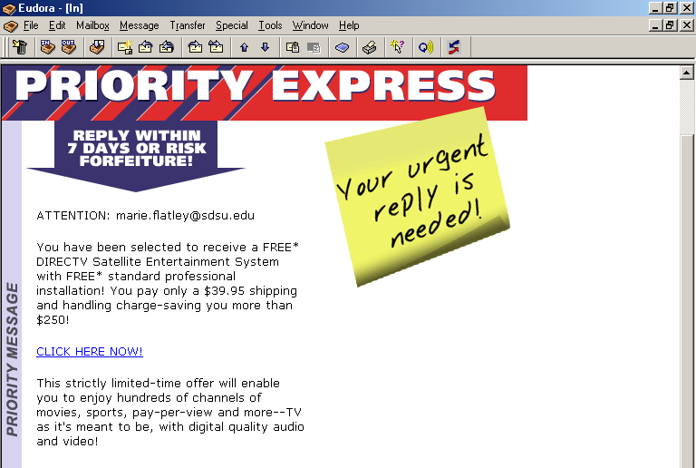
Opens with an attention-getter
Reasons stress reader benefit

Slide 25
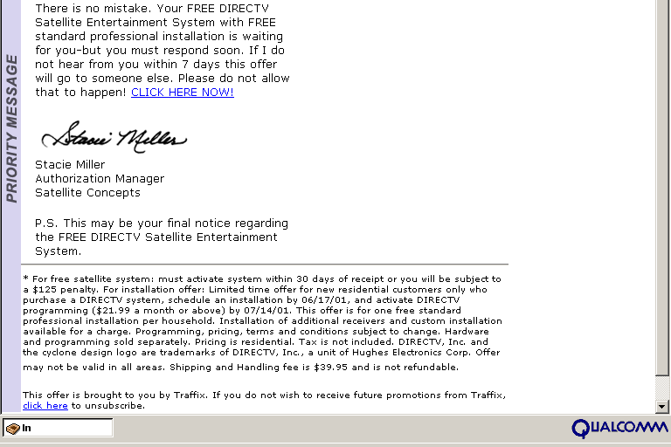
Call for action is clear and easy
Postscript adds that extra punch
Opt-out message included

Slide 26
“If you want to succeed, you should strike out on new paths rather than travel the worn paths of accepted success.”
--John D. Rockefeller

